Slide 1
Network Administration
Final Demo and Bonus
changhoy, tcyuan

Slide 2
Outline
Demo Flow
HW4 (25%)
Bonus (+10%)
Bonus Requirements
Final Q & A
Scoring Structure
Demo Preparation
Meeting Room Overview
Help

Slide 3
Demo Flow - HW4
Check if query to LDAP consumer first (5%)
Check “cn=syncuser” not exist in LDAP consumer (10%)
Check custom script “addnasauser” script work fine (10%)

Slide 4

Bonus Requirements
Dovecot Integration with LDAP
Allow LDAP users to login your mail server
Allow LDAP users to send/receive mail to/from others
Be able to send mail to LDAP user stu<ID> from local user cool-TA

Slide 5
Demo Flow - Bonus
Use smtp with user cool-TA to send an email to stu{ID}
Use imap to login to stu{ID} and show inbox
Use smtp with user stu{ID} to send an email to cool-TA
Use imap to login to cool-TA and show inbox
Note: Prepare your demo script prior to DEMO time

Slide 6
Scoring Structure
Scoring Structure
Online Judge 75% + Demo 25% + Bonus 10%
Failed to complete Demo + Q&A will results in a loss of 20% credit

Slide 7
Demo Preparation
Make sure you can use Gather without obstacles. i.e.
You can walk around within the room
Your speaker / headset is working
Your microphone is working
Your screen sharing is working

Slide 8

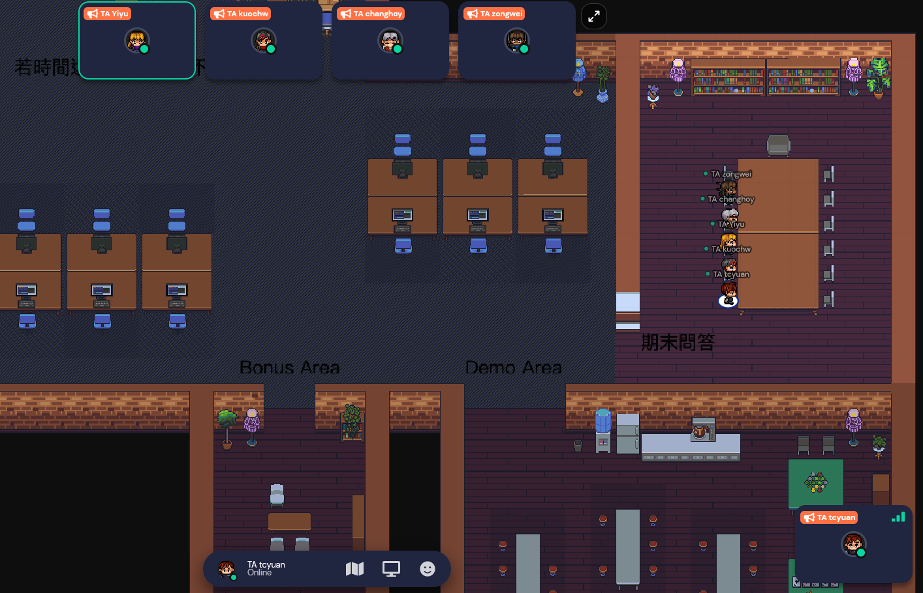
Meeting Room Overview
Room Link: https://gather.town/i/uOZ0fIc4
Do not Enter the room until it’s your turn
Join the room with student ID being your name
Enter the Bonus or Demo room as required by TA
Move to other rooms when told to do so
Gather into room 期末問答
Q & A session with both students

Slide 9
Help
Due to the pandemic, NO TA office hours
Please ask your questions online
Questions about this homework.
Make sure you have studied through lecture slides and the HW spec.
Clarify your problems and search it to find out solutions first.
Ask them on https://groups.google.com/g/nctunasa .
Be sure to include all the information you think others would need.

